Slide 1
Alarms and Schedulers
Android Developer Fundamentals V2
Lesson 8

Slide 2
8.1 Notifications

Slide 3
Contents
What are notifications?
Notification channels
Creating a notification channel
Creating notifications
Tap action and action buttons
Expanded view notifications
Delivering notifications
Managing Notifications

Slide 4
What Are Notifications?

Slide 5
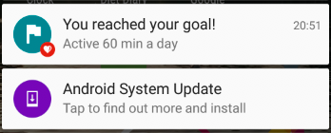
What is a notification?
Message displayed to user outside regular app UI
Small icon
Title
Detail text

Slide 6
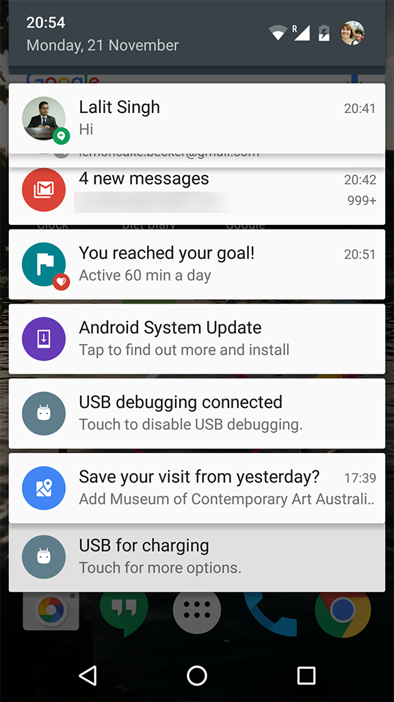
How are notifications used?
Android issues a notification that appears as icon on the status bar.
To see details, user opens the notification drawer.
User can view notifications any time in the notification drawer.

Slide 7
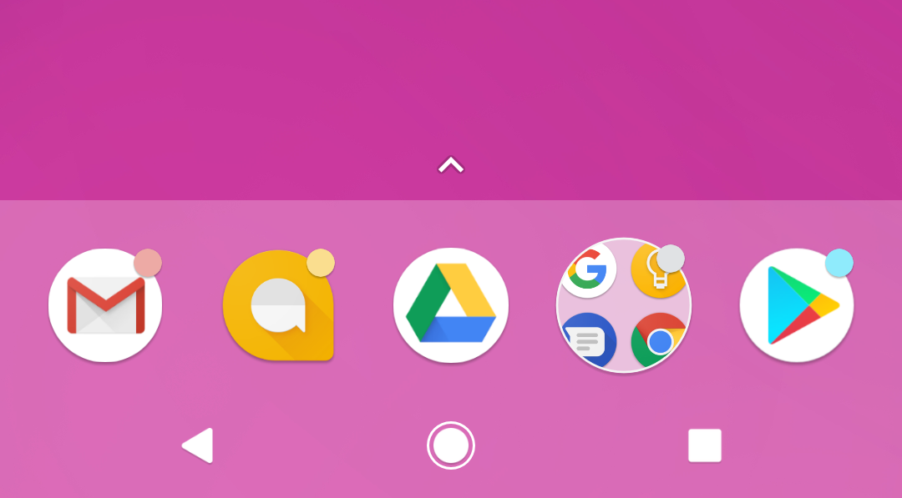
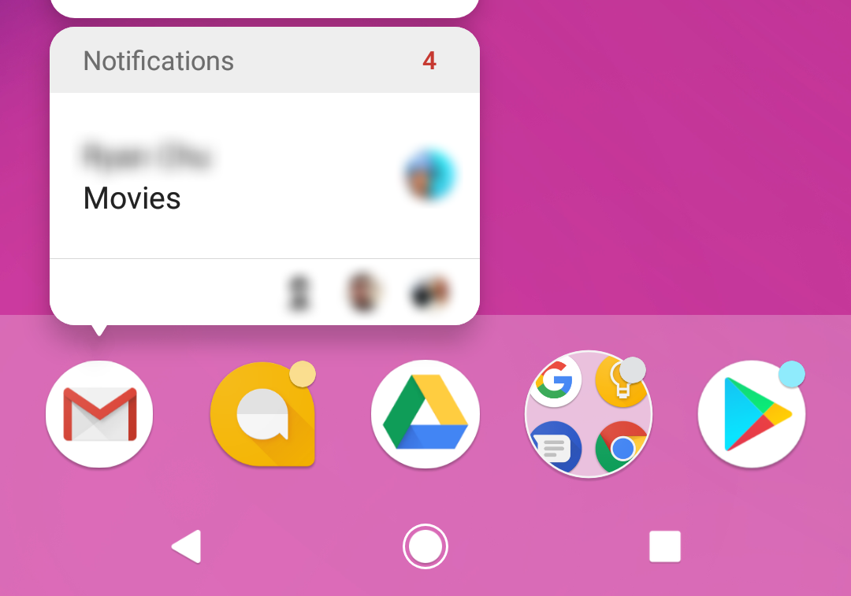
App icon badge
Available only on the devices running Android 8.0 (API level 26) and higher.
New notifications are displayed as a colored "badge" (also known as a "notification dot") on the app icon.
Users can long-press on an app icon to see the notifications for that app. Similar to the notification drawer.

Slide 8
Notification
Channels

Slide 9
Notification channels
Used to create a user-customizable channel for each type of notification to be displayed.
More than one notification can be grouped in to a channel.
Set notification behavior like sound, light, vibrate and so on, applied to all the notifications in that channel.

Slide 10
Notification channels are mandatory
Notification channels are introduced in Android 8.0 (API level 26)
All notifications must be assigned to a channel starting from Android 8.0 (API level 26), else your notifications will not be displayed.
For the apps targeting lower than Android 8.0 (API level 26), no need to implement notification channels.

Slide 11
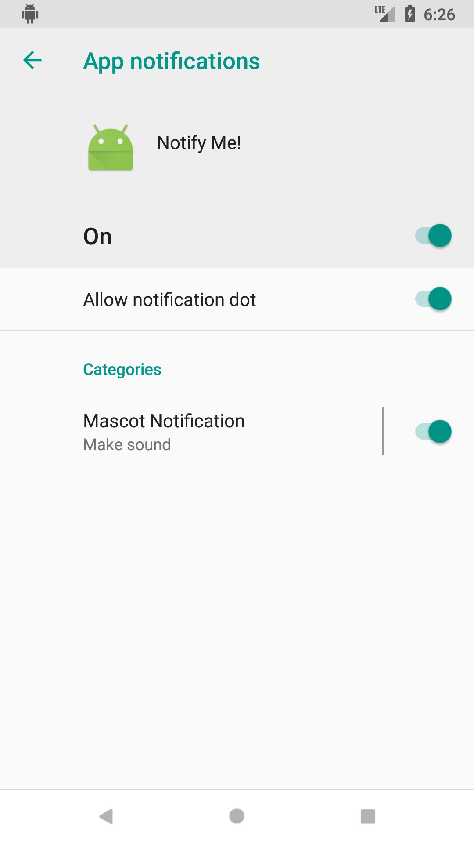
Notification channels in Settings
Notification channels appear as Categories under App notifications in the device Settings.

Slide 12
Creating a Notification channel

Slide 13
Create a Notification channel
Notification channel instance is created using NotificationChannel constructor.
You must specify:
An ID that's unique within your package.
User visible name of the channel.
The importance level for the channel.
if (Build.VERSION.SDK_INT >= Build.VERSION_CODES.O) {
NotificationChannel notificationChannel =
new NotificationChannel(CHANNEL_ID, "Mascot Notification",
NotificationManager.IMPORTANCE_DEFAULT);
}

Slide 14
Importance level
Available in Android 8.0 (API level 26) and higher.
Sets the intrusion level, like the sound and visibility for all notifications posted in the channel.
Range from IMPORTANCE_NONE(0) to IMPORTANCE_HIGH(4).
To support earlier versions of Android (Lower than API level 26), set the priority.

Slide 15
Notification priority
Determines how the system displays the notification with respect to other notifications, in Android version Lower than API level 26.
Set using the setPriority() method for each notification.
Range from PRIORITY_MIN to PRIORITY_MAX.
setPriority(NotificationCompat.PRIORITY_HIGH)

Slide 16
Importance level and priority constants
User-visible importance level | Importance (Android 8.0 and higher) | Priority (Android 7.1 and lower)
Urgent Makes a sound and appears as a heads-up notification | IMPORTANCE_HIGH | PRIORITY_HIGH or PRIORITY_MAX
High Makes a sound | IMPORTANCE_DEFAULT | PRIORITY_DEFAULT
Medium No sound | IMPORTANCE_LOW | PRIORITY_LOW
Low No sound and doesn't appear in the status bar | IMPORTANCE_MIN | PRIORITY_MIN

Slide 17
Creating Notifications

Slide 18
Creating Notification
Notification is created using NotificationCompat.Builder class.
Pass the application context and notification channel ID to the constructor.
The NotificationCompat.Builder constructor takes the notification channel ID, this is only used by Android 8.0 (API level 26) and higher, but this parameter is ignored by the older versions.
NotificationCompat.Builder mBuilder = new
NotificationCompat.Builder(this, CHANNEL_ID);

Slide 19
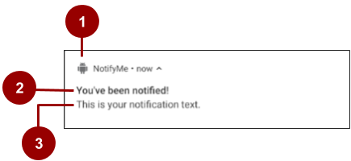
Setting notification contents
A small icon, set by setSmallIcon().
This is the only content that's required.
A title, set by setContentTitle().
The body text, set by setContentText(). This is the notification message.

Slide 20
Setting notification contents
NotificationCompat.Builder mBuilder =
new NotificationCompat.Builder(this, CHANNEL_ID)
.setSmallIcon(R.drawable.android_icon)
.setContentTitle("You've been notified!")
.setContentText("This is your notification text.");

Slide 21
Tap action
and
Action buttons

Slide 22
Add notification tap action
Every notification must respond when it is tapped, usually launching an Activity in your app.
Set an content intent using setContentIntent() method.
Pass the Intent wrapped in a PendingIntent object.

Slide 23
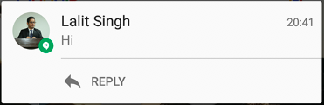
Notification action buttons
Action buttons can perform a variety of actions on behalf of your app, such as starting a background task, placing a phone call and so on.
Starting from Android 7.0 (API level 24) reply to messages directly from notifications.
To add an action button, pass a PendingIntent to the addAction() method.

Slide 24
Pending intents
A PendingIntent is a description of an intent and target action to perform with it.
Give a PendingIntent to another application to grant it the right to perform the operation you have specified as if the other app was yourself.

Slide 25
Methods to create a PendingIntent
To instantiate a PendingIntent, use one of the following methods:
PendingIntent.getActivity()
PendingIntent.getBroadcast()
PendingIntent.getService()

Slide 26
PendingIntent method arguments
Application context
Request code—constant integer id for the pending intent
Intent to be delivered
PendingIntent flag determines how the system handles multiple pending intents from same app

Slide 27
Step 1: Create intent
Intent notificationIntent =
new Intent(this, MainActivity.class);

Slide 28
Step 2: Create PendingIntent
PendingIntent notificationPendingIntent =
PendingIntent.getActivity(
this, NOTIFICATION_ID,
notificationIntent, PendingIntent.FLAG_UPDATE_CURRENT);

Slide 29
Step 3: Add to notification builder
To set tap action to the notification:
.setContentIntent(notificationPendingIntent);

Slide 30

Add action buttons
Use NotificationCompat.Builder.addAction() — pass in icon, caption, PendingIntent
.addAction(R.drawable.ic_color_lens_black_24dp, "R.string.label", notificationPendingIntent);

Slide 31
Expanded view notifications

Slide 32
Expandable notifications
Notifications in the notification drawer appear in two main layouts, normal view (which is the default) and expanded view.
Expanded view notifications were introduced in Android 4.1.
Use them sparingly -- they take up more space and attention.

Slide 33
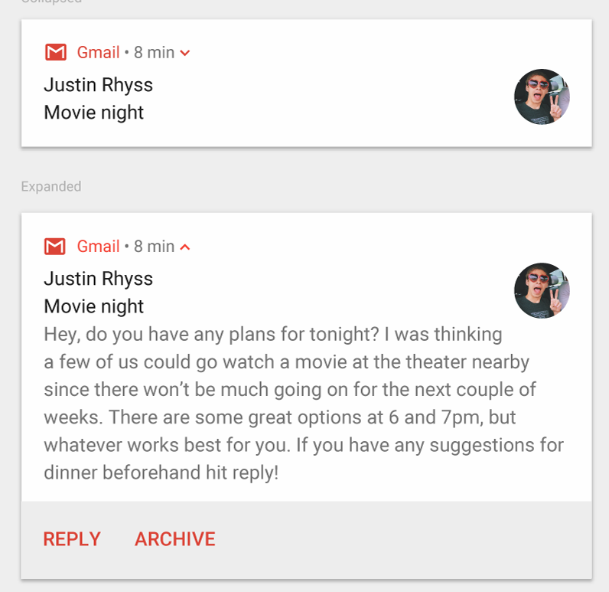
Big text
For large-format notifications that include a lot of text.
Fits more text than a standard view.
Use the helper class:
NotificationCompat.BigTextStyle

Slide 34
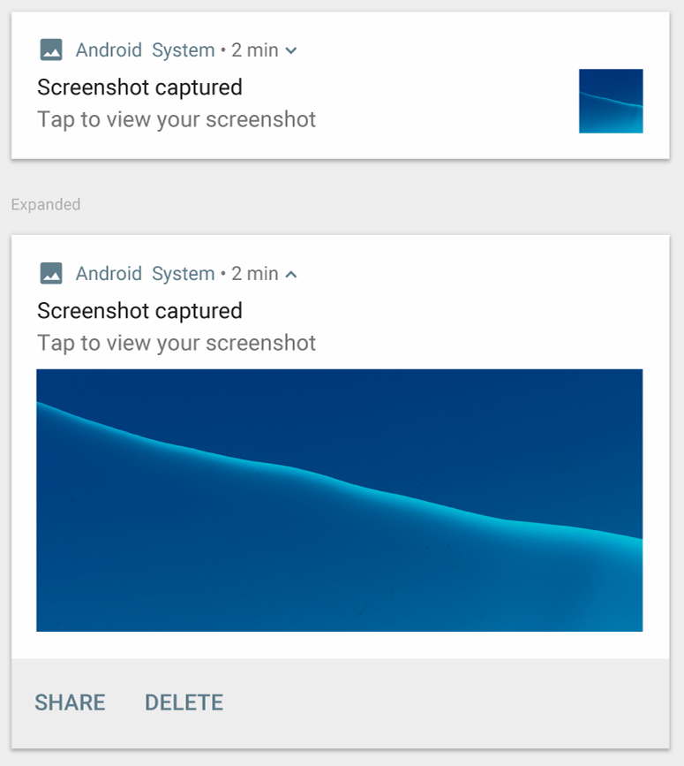
Big image
For large-format notifications that include a large image attachment.
Use the helper class:
NotificationCompa.BigPictureStyle

Slide 35
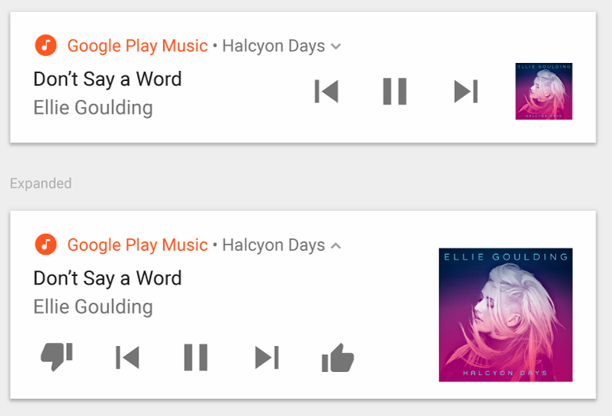
Media
For media playback notifications.
Actions for controlling media such as music
Image for album cover
Use the helper class:
NotificationCompat.MediaStyle

Slide 36
Managing Notifications
Setting styles
To create expandable notification that appear, use one of the helper classes to set the style using the setStyle() method.
mNotifyBuilder
.setStyle(new NotificationCompat.BigPictureStyle()
.bigPicture(myBitmapImage)
.setBigContentTitle("Notification!"));

Slide 37
Delivering Notifications

Slide 38
Building a Notification
Delivering notifications
Use the NotificationManager class to deliver notifications.
Create an instance of NotificationManager
Call notify() to deliver the notification.

Slide 39
Building a Notification
Instantiate NotificationManager
Call getSystemService(), passing in the NOTIFICATION_SERVICE constant.
mNotifyManager = (NotificationManager)
getSystemService(NOTIFICATION_SERVICE);

Slide 40
Building a Notification
Send notification
Call notify()to deliver the notification, passing in these two values:
A notification ID, which is used to update or cancel the notification.
The NotificationCompat object that you created using the NotificationCompat.Builder object.
mNotifyManager.notify(NOTIFICATION_ID, myNotification);

Slide 41
Managing Notifications

Slide 42
Managing Notifications
Updating notifications
Update a notification by changing and or adding some of its content.
Issue notification with updated parameters using builder.
Call notify() passing in the same notification ID.
If previous notification is still visible, system updates.
If previous notification has been dismissed, new notification is delivered.

Slide 43
Managing Notifications
Canceling notifications
Notifications remain visible until:
User dismisses it by swiping or by using "Clear All".
Calling setAutoCancel() when creating the notification, removes it from the status bar when the user clicks on it.
App calls cancel() or cancelAll() on NotificationManager.
mNotifyManager.cancel(NOTIFICATION_ID);

Slide 44
Design guidelines
If your app sends too many notifications, users will disable notifications or uninstall the app.
Relevant: Whether this information is essential for the user.
Timely: Notifications need to appear when they are useful.
Short: Use as few words as possible.
Give users the power to choose -- Use appropriate notification channels to categorise your notifications.

Slide 45
What's Next?
Concept Chapter: 8.1 Notifications
Practical: 8.1 Notifications

Slide 46
The End

